Slide 1
Winning Ways to Witness
SALT Discipleship Training
How to meet community needs
David Hartman
www.winningwaystowitness.com .
z
Notes:
MODELO- Monitor 01B

Slide 2
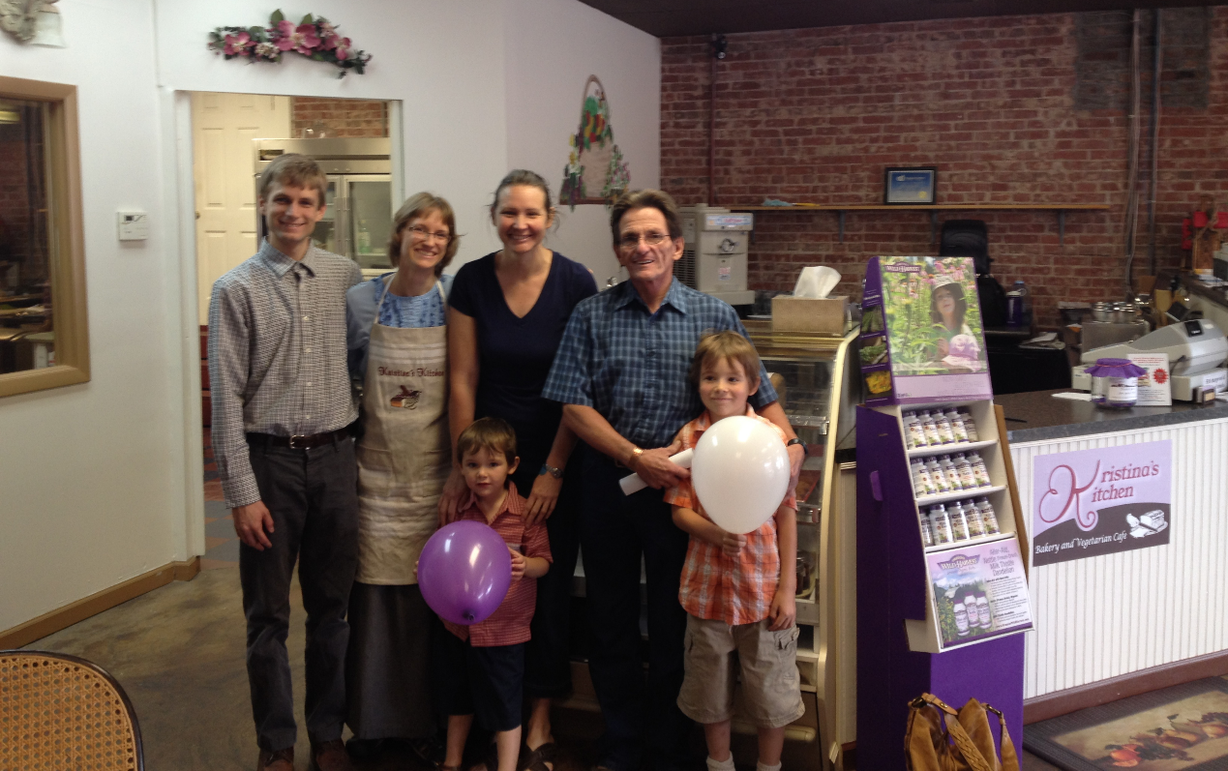
7 Ways to Reach Your Friends for Christ
Kristina’s Kitchen Cooking Classes & Vegan Restaurant
David Hartman
www.winningwaystowitness.com
t
Notes:
When Daniel and Kristina McFeeters got married in March 2009, they prayed that God would send them to a mission field in the United States. God providentially led them to McCreary County, a rural Appalachian community in eastern Kentucky and the poorest county in the United States. Their first priority was to do cultural research—to get to know the people and understand their unique backgrounds, way of life, perspectives, interests, concerns, and needs, thus enabling the McFeeters to serve their community and share Jesus in a practical way. One of the first needs they discovered was poor health caused by a deficient diet. Daniel and Kristina are not health professionals. They own a computer business called FiForms Solutions, where they do custom software development and network engineering on a contract basis. Daniel is also the IT director for the Health Department for ten counties in eastern Kentucky.1 However, they both have an interest in healthy lifestyles, and Kristina enjoys cooking.
So, after much prayer, the McFeeters felt impressed to make a difference in the health of their community by starting a simple monthly class on how to prepare fruits and vegetables. Each class features one fruit or vegetable with a meal, recipes, and a health talk focused on that fruit or vegetable. This class called Healthy Living Seminars began in October 2009 in Whitley City with 12 participants, but soon grew to 25, all personal contacts the McFeeters had made in the community. During the next few months, word of the cooking classes spread through McCreary County and into adjacent counties. Kristina began getting offers from public health officials, community centers, and health food stores to conduct additional health classes, such as a once-a-month class in Somerset, an eight-week weight-loss class, a diabetes reversal class, a booth at the county health fair, a booth at the diabetes fair, and a week-long “kids’ cooking college.”
On June 11, 2014, God opened one more miraculous door and fulfilled a lifelong dream when Kristina’s Kitchen, a vegetarian café and bakery, was opened to the public, serving a tasty fare of vegetable soup, sandwiches, salads, and baked delights. One customer (Victoria) who attends Kristina’s cooking classes and frequents the café used to experience shortness of breath, lack of energy, and excessive weight. However, due to following this new prescribed diet, she has dropped over 20 pounds, and her family’s health has remarkably improved. She testifies, “Kristina’s cooking class was the turning point for us—it changed our meals and our lives.”
What started as a young couple’s willingness to go to the “mission field” and to devote one day a month to outreach ministry has escalated into multiple ministry opportunities and hundreds of touched lives. Serving health needs in the community has opened doors to serving spiritual needs as well. When we serve people in Christ’s name, it opens up hearts to the gospel.

Slide 3
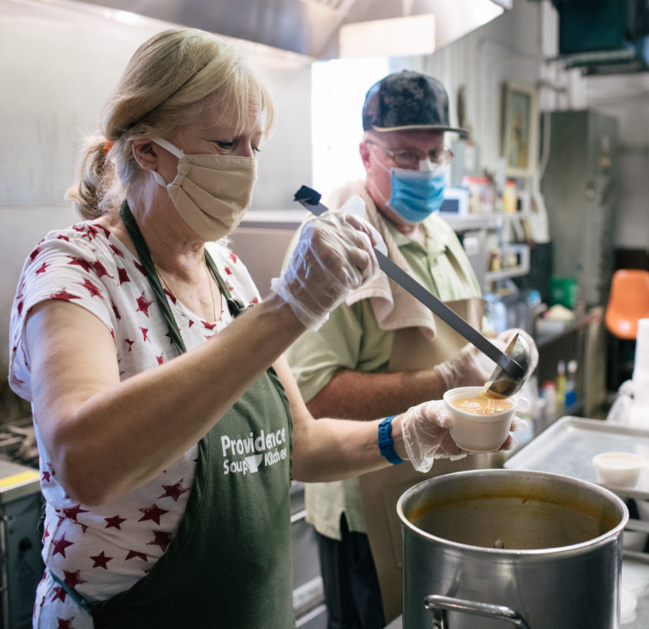
7 Ways to Reach Your Friends for Christ
WHY Meet Needs of Community?
Meeting real needs in practical ways—opens hearts to God’s love.
Titus 3:14
Key to “fruitfulness” - meeting “urgent needs”
David Hartman
www.winningwaystowitness.com
t
Notes:
“And let our people also learn to maintain good works, to meet urgent needs, that they may not be unfruitful.” Titus 3:14
What will cause our churches to be fruitful and win people to Christ? Meeting urgent needs!
When I served in KTC as Ministerial Director, about a third of our churches had not had baptisms in 3-5 years? Why? Could it be because we’re not meeting urgent needs!

Slide 4
7 Ways to Reach Your Friends for Christ
Different Levels of Receptivity
Antagonistic
Resistant
Receptive
Indifferent
Seeking
David Hartman
www.winningwaystowitness.com
Notes:
There is a continuum of faith journey. People on the lower end of the scale will never read a GLOW tract, take a BS, or come to an evangelistic meeting.
With them, we must start with meeting urgent needs, this will gradually open their hearts where they become receptive to spiritual things.

Slide 5
7 Ways to Reach Your Friends for Christ
“First meet the temporal necessities . . . And relieve their physical wants and sufferings, and you will then find an open avenue to the heart, where you may plant the good seeds of virtue and religion.” EGW, Testimonies, vol. 4, p. 227
David Hartman
www.winningwaystowitness.com
z
Notes:
MODELO- Monitor 01B

Slide 6
7 Ways to Reach Your Friends for Christ
“Thirty years ago the most effective form of evangelism was widely believed to be a straight-out, in-your-face, confront-the-sinner declaration of salvation available through Christ. A decade or two ago, evangelism shifted to a focus on personal relationships, cultivated with eternity in mind. We believe we are undergoing another shift today, wherein doing good in the world is a powerful apologetic to those who are seeking God.” Barna & Kinnaman, Churchless, p. 181 (2014)
David Hartman
www.winningwaystowitness.com
t
Notes:
MODELO- Monitor 01B

Slide 7
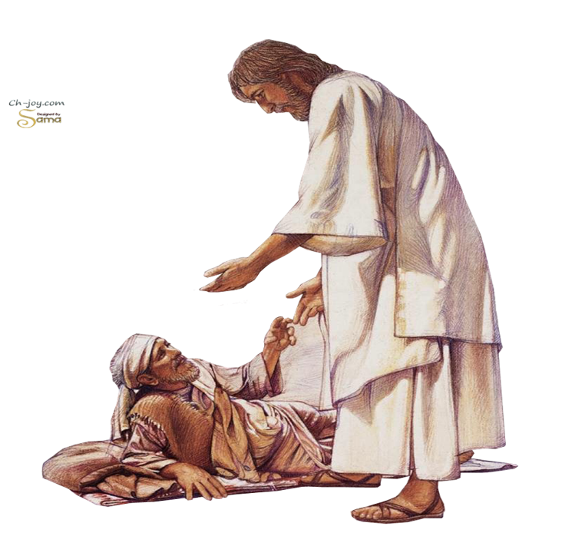
7 Ways to Reach Your Friends for Christ
Biblical Examples:
Dorcas (Acts 9:36)
Jesus (Acts 10:38)
- “went about doing good”
“From His earliest years He [Jesus] was possessed of one purpose: He lived to bless others.” EGW, Desire of Ages, p. 70
David Hartman
www.winningwaystowitness.com
t
Notes:
Dorcas was “full of good works and charitable deeds.”
Jesus “went about doing good and healing all who were oppressed by the devil, for God was with Him.”

Slide 8
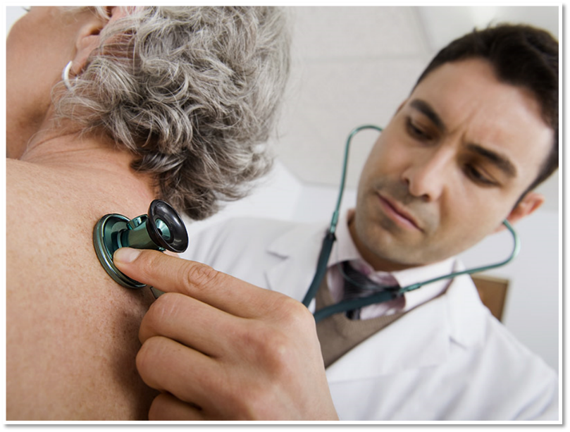
7 Ways to Reach Your Friends for Christ
HOW Meet Needs of Community?
David Hartman
www.winningwaystowitness.com
z
Notes:
Run out and conduct cooking class, Smoking cessation class?
What would you think of a medical doctor who treated before he diagnosed?

Slide 9
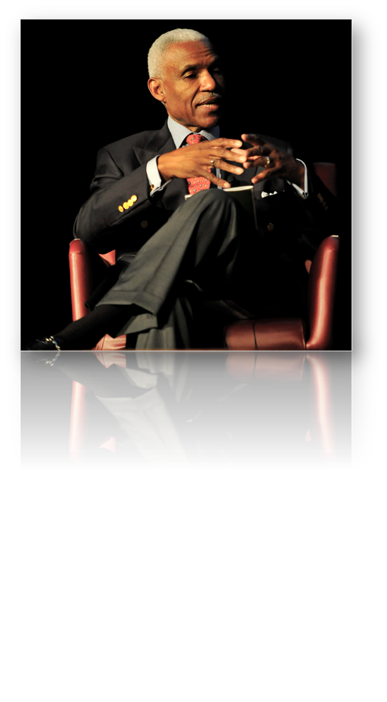
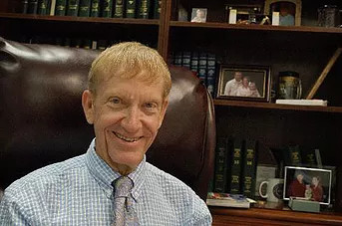
Community Assessment
Listen to the “heartbeat” of your community. What are the “real needs”?
Consult with community leaders and agencies
z
Notes:
When I lived in Portland TN and pastored the Highland Academy Church, I got to know Mayor Kenneth Wilbur. Also served on the Portland Chamber of Commerce board and got to know city officials. One of the needs was Richland Park, needed maintenance and upkeep. Our church adopted it.
When I was Ministerial Director, the area Memphis pastors scheduled an appointment to meet with A.C. Wharton, the mayor of Memphis. They asked, Mayor, how can we help you achieve your dreams for the city? What can we do to serve Memphis? He was flabbergasted, because most churches who came to see him wanted to push their agenda. He shared a dream for 100 homeless families to be adopted by local churches. We adopted several of those families.

Slide 10
Community Assessment
Listen to the “heartbeat” of your community. What are the “real needs”?
Consult with community leaders and agencies
Engage in community events and organizations
z
Notes:
MODELO- Monitor 01B

Slide 11
7 Ways to Reach Your Friends for Christ
Community Events
Red Ribbon Parade (drug awareness)
Church Choir (Highland & McKendree Methodist)
Community Thanksgiving Service
Community Choir Night
Holy Week
National Day of Prayer
David Hartman
www.winningwaystowitness.com
t
Notes:
Example of the Highland Adventist Church
Here are some ideas that we tried at the Highland Seventh-day Adventist Church during the 12 years I pastored there. Every year the city of Portland, Tennessee, sponsored a Red Ribbon Parade for drug awareness. For years our Highland church and school participated with a float in the parade, and our members lined the streets, cheering for all of the floats. Both our city and our local ministerial association planned various events throughout the year, such as an annual Thanksgiving program, a Christmas tree lighting, a church choir night, and a National Day of Prayer breakfast. We encouraged our members to support all of these community events.
We also encouraged members to join local civic clubs and charity organizations, such as Kiwanis International, Lions Club, Portland C.A.R.E.S., Meals on Wheels, and Cancer Relay for Life. For years some of the young adults in our church formed a softball team that played other church and corporate teams (you may have to bow out of Friday night games, but this gives you opportunities to witness). Our Highland Adventist Church also participated with the McKendree Methodist Church in a joint choir that performed an annual Christmas concert, first at Highland on Saturday morning and then at McKendree on Sunday morning. This has fostered a lot of goodwill between the two churches. I have also been an active member of the ministerial association and have helped plan citywide religious and charity events, as well as serving on the Chamber of Commerce Board and becoming acquainted with the city mayor, council members, and civic leaders. These social interactions break down barriers and create good relationships so that local churches, pastors, and civic leaders know that Adventists are real Christians who love, care for, and serve their communities.

Slide 12
7 Ways to Reach Your Friends for Christ
Community Organizations
Service Clubs: Rotary, Kiwanis, Lions, etc.
Red Cross/County disaster & Community Service programs.
Food Banks, Meals on Wheels, Habitat for Humanity, Samaritan Center.
Softball League
Chamber of Commerce (president, mayor, city council)
Ministerial Association
David Hartman
www.winningwaystowitness.com
t
Notes:
Example of the Highland Adventist Church
Here are some ideas that we tried at the Highland Seventh-day Adventist Church during the 12 years I pastored there. Every year the city of Portland, Tennessee, sponsored a Red Ribbon Parade for drug awareness. For years our Highland church and school participated with a float in the parade, and our members lined the streets, cheering for all of the floats. Both our city and our local ministerial association planned various events throughout the year, such as an annual Thanksgiving program, a Christmas tree lighting, a church choir night, and a National Day of Prayer breakfast. We encouraged our members to support all of these community events.
We also encouraged members to join local civic clubs and charity organizations, such as Kiwanis International, Lions Club, Portland C.A.R.E.S., Meals on Wheels, and Cancer Relay for Life. For years some of the young adults in our church formed a softball team that played other church and corporate teams (you may have to bow out of Friday night games, but this gives you opportunities to witness). Our Highland Adventist Church also participated with the McKendree Methodist Church in a joint choir that performed an annual Christmas concert, first at Highland on Saturday morning and then at McKendree on Sunday morning. This has fostered a lot of goodwill between the two churches. I have also been an active member of the ministerial association and have helped plan citywide religious and charity events, as well as serving on the Chamber of Commerce Board and becoming acquainted with the city mayor, council members, and civic leaders. These social interactions break down barriers and create good relationships so that local churches, pastors, and civic leaders know that Adventists are real Christians who love, care for, and serve their communities.

Slide 13
Community Assessment
Listen to the “heartbeat” of your community. What are the “real needs”?
Consult with community leaders and agencies
Engage in community events and organizations
Conduct community survey
z
Notes:
MODELO- Monitor 01B

Slide 14
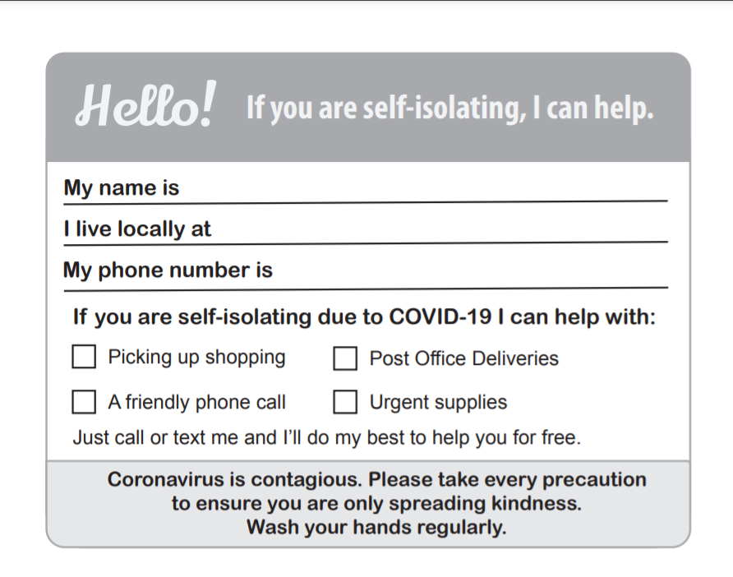
https://ministerial.adventist.org/covid19
7 Ways to Reach Your Friends for Christ
ministerial.adventist.org/covid19
Community Survey
David Hartman
www.winningwaystowitness.com
z
Notes:
Great website for all sorts of resources: ministerial.adventist.org/covid19

Slide 15
7 Ways to Reach Your Friends for Christ
In which of the following services would you have an interest?
Nutrition and vegetarian cooking classes
Weight control seminar
Visiting and prayer for the sick
Care for the elderly
Clothing and food assistance
Ministry in crisis (bereavement, grief, mid-life, other)
Marriage enrichment seminar
Parenting skills for children and adolescents
Youth and peer pressure management
Mentoring and counseling program for youth
Substance abuse
Classes on the meaning of life/my relationship with God
In your own words, identify the three most urgent needs in your neighborhood.
https://www.sabbathschoolpersonalministries.org/community-services-handbook.pdf
Community Survey
David Hartman
www.winningwaystowitness.com
z
Notes:
https://www.sabbathschoolpersonalministries.org/community-services-handbook.pdf

Slide 16
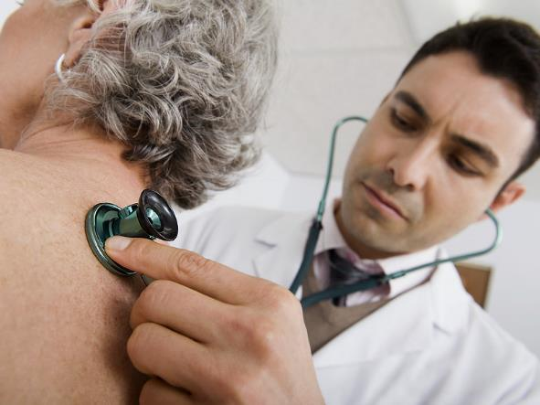
Community Assessment
Listen to the “heartbeat” of your community. What are the “real needs”?
Consult with community leaders and agencies
Engage in community events and organizations
Conduct community survey
MissionInsite Demographic Resource
z
Notes:
MODELO- Monitor 01B

Slide 17
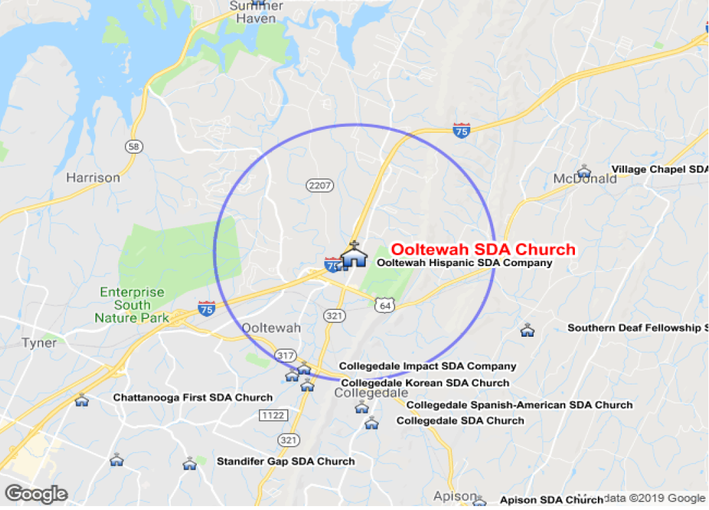
MissionInsite.com
2.5 Radius Report
Population: 15,372
36.8% growth since 2000
Notes:
MissionInsite.com is a demographic resource that enables you to “hear” the heartbeat of your community. 2 ½ mile radius around Ooltewah Church. Can also do a polygram shape.

Slide 18
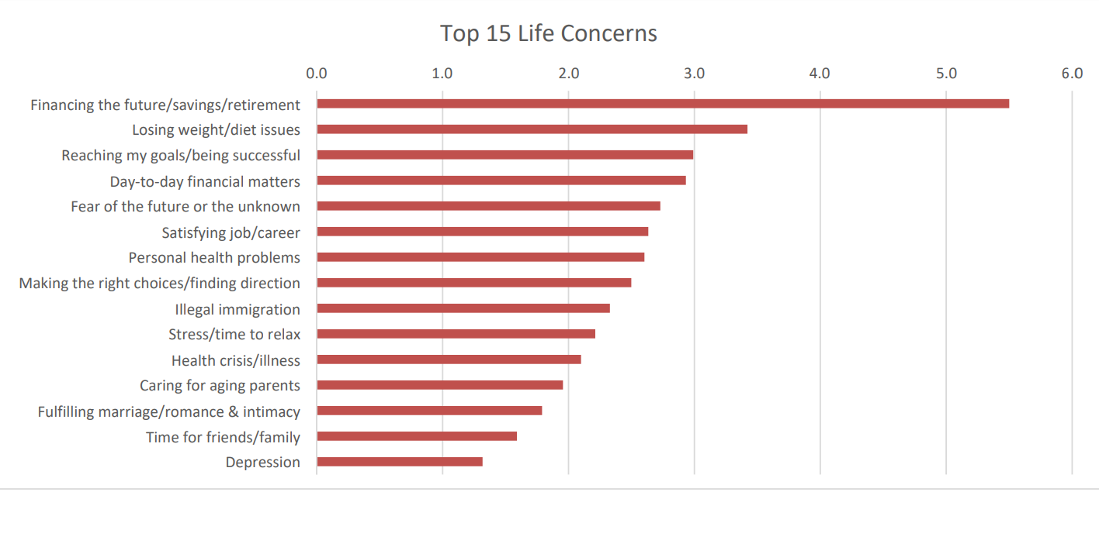
MissionInsite.com
Notes:
MissionInsite.com is a demographic resource that enables you to “hear” the heartbeat of your community. Define your area by a Polygram shape then gives a breakdown of the 71 different House Hold Types within your territory—each with their unique interests, hurts and needs.

Slide 19
Mission Action Plan (MAP)
Step 1
1. Pause for prayer for God’s guidance, direction, and insights (2 min)
2. Identify three of the top needs in your community from the MissionInsite report (3 min).
3. Brainstorm creative, practical ways your church might meet those needs (just list, don’t evaluate at this point) (5 min).
4. Evaluate your list and circle the ministry that would be most impactful at this time (10 min).
Community Need #1 _________________________
1.
2.
3.
4.
5.

Slide 20
Mission Action Plan (MAP)
Step 1
Develop a concrete Action Plan with specific assignments and deadlines for each ministry. Show how you will provide time and resources to maximize your effort.
Ministry Description and Objective | Action Steps | Target Date | Person Responsible | Budget
#1 #1

Slide 21
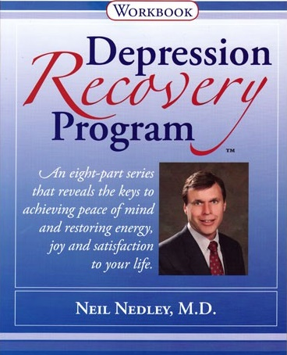
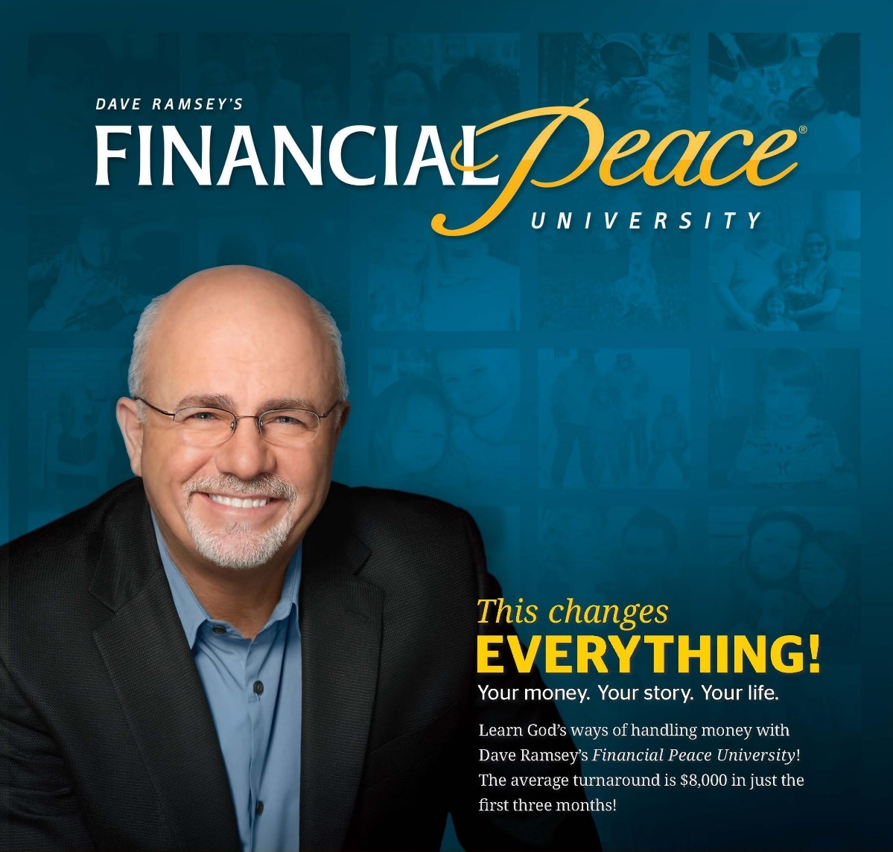
Offer culturally relevant outreach events
z
Notes:
MODELO- Monitor 01B

Slide 22
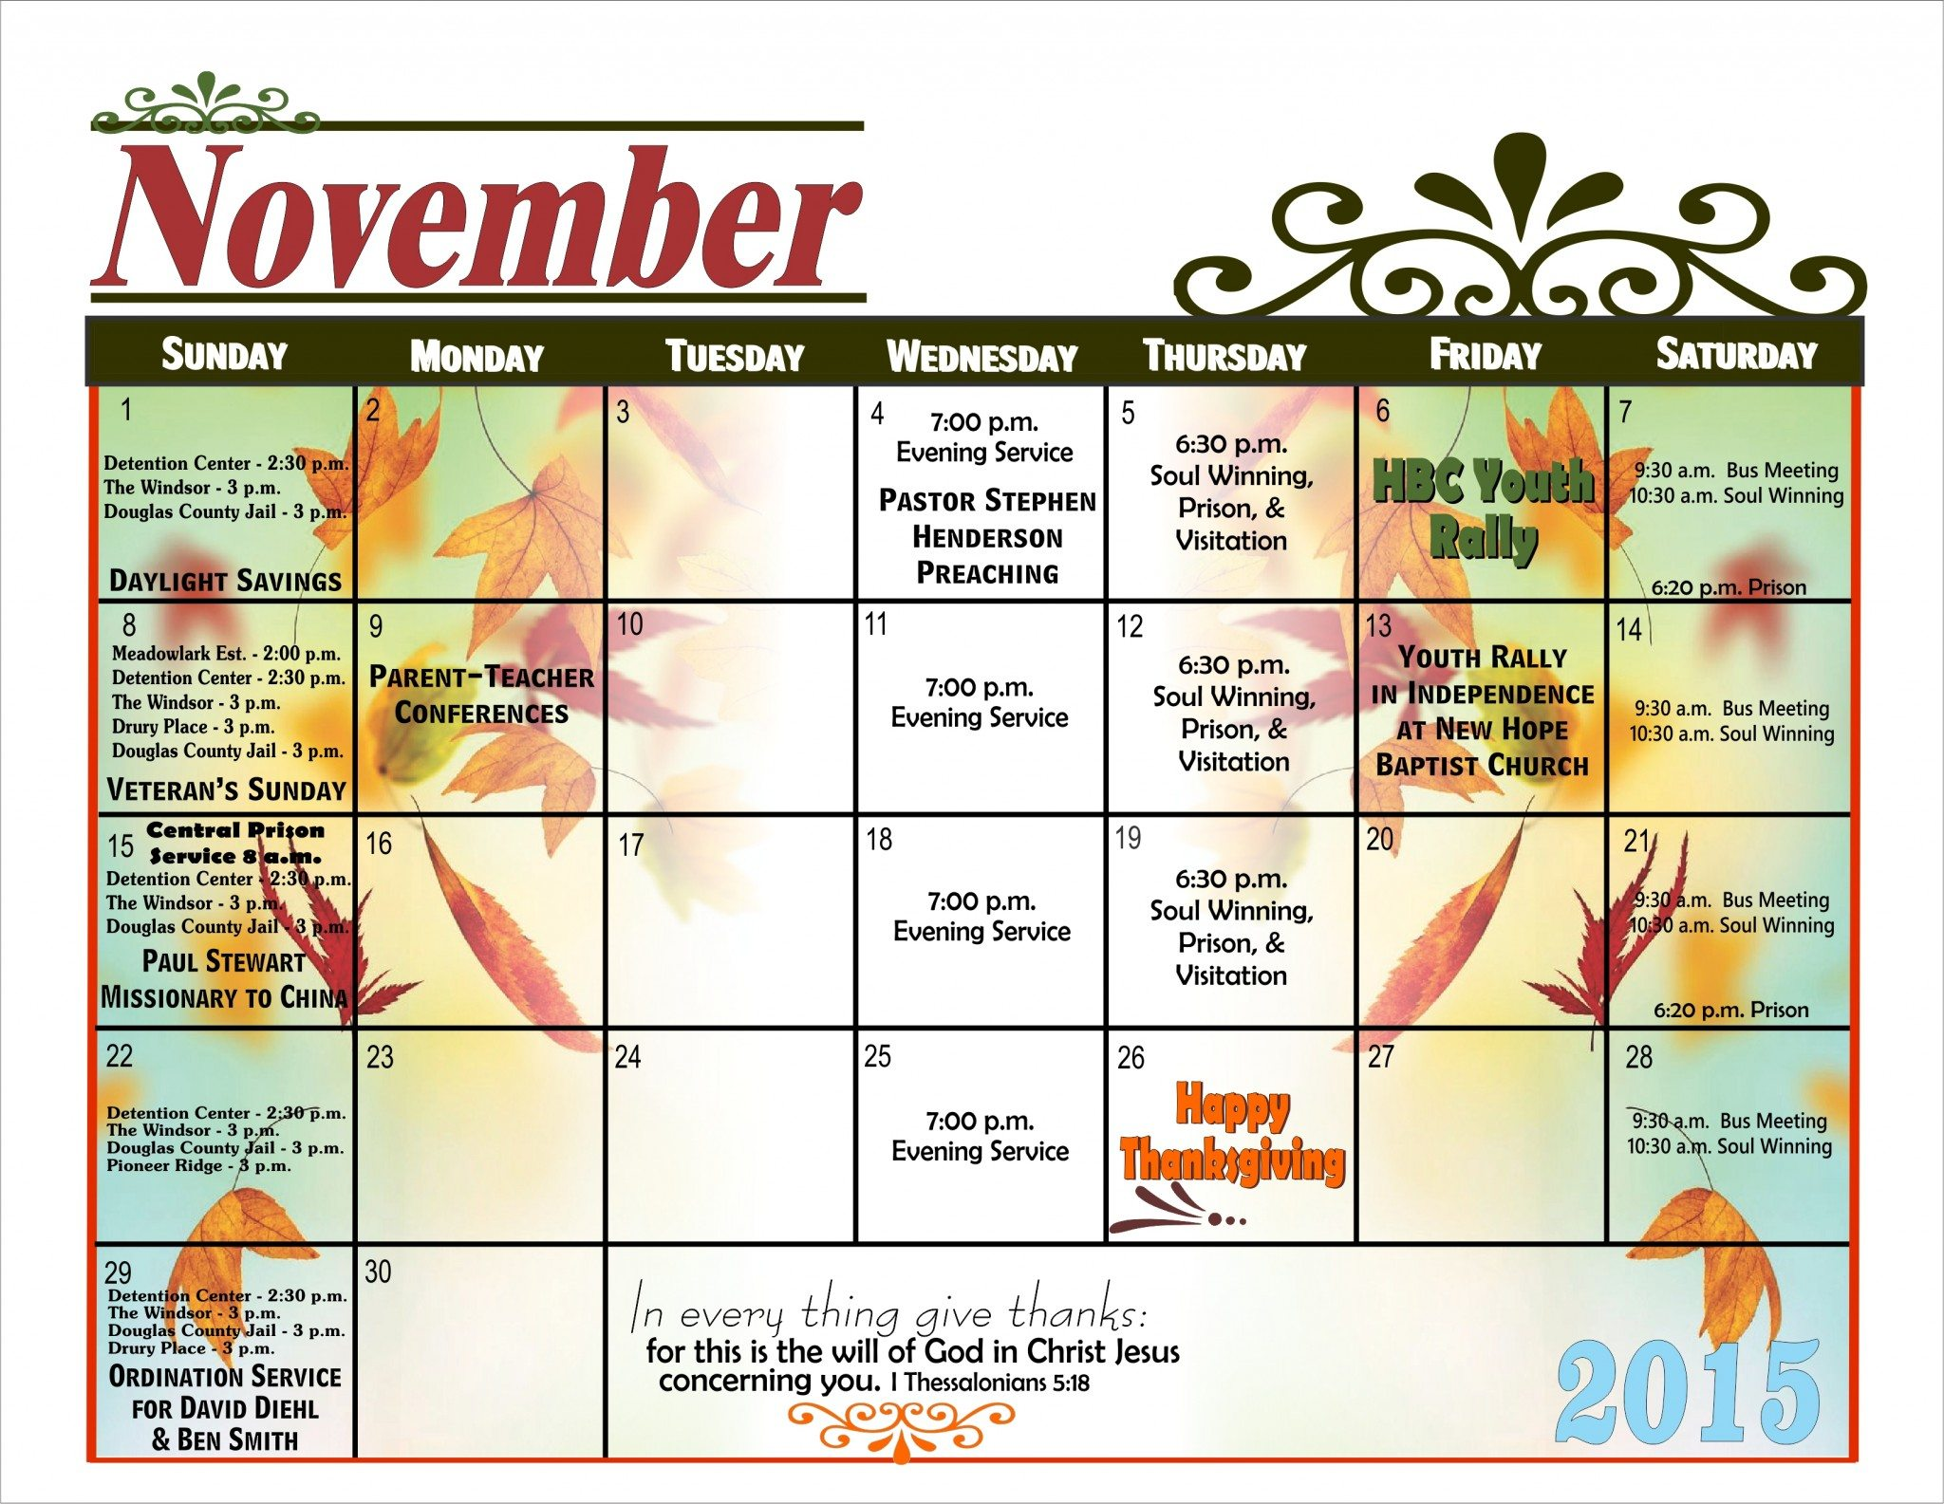
Rule of thumb for frequency:
Plan monthly service projects (compassion weekends)
And quarterly outreach seminars
z
Notes:
MODELO- Monitor 01B

Slide 23
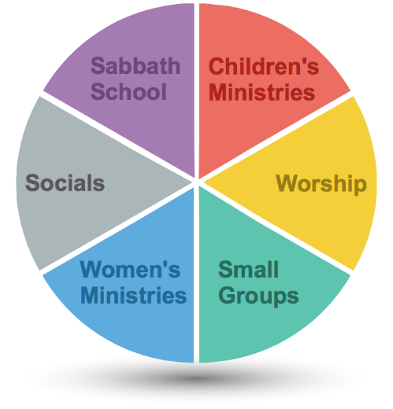
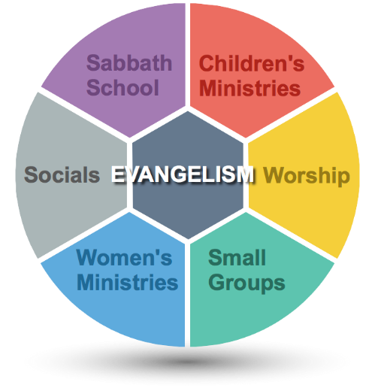
Evangelism Centered Church PIE vs. HUB
Focus every phase of church life on evangelism.
Ask every department/leader to contribute to a service project in the community.
z
Notes:
How can we serve our community?

Slide 24
Go Light Your World
Every Member: Arenas
Restaurant
Work
Neighborhood
Shopping
School
Hair Stylist, Mechanic, fitness center
Luci at Sam’s Club
Waitress at Restaurant
M&M at local school
Hair stylist Toni
Walt’s Garage
Neighbor Susan
“Jesus went about doing good.”
Acts 10:38
“Uttermost parts of the earth.”
Acts 1:8
Disaster Response
Mission Trips
David Hartman
www.winningwaystowitness.com
z
Notes:
Examples of Service Opportunities:
Here are some of the service opportunities that God has put in my path the past several years. Maybe this will help spark some ways you might bless others as well.
Several years ago I was checking out at Sam’s Club with my cart of goods when I ran into Luci. She is the person who visually scans the items in your cart and on your receipt, and then marks your receipt with a yellow highlighter. I had previously engaged in conversation with Luci on multiple occasions while shopping there. She stands out because she is always so cheerful and personable. On this particular day, she exclaimed with her usual smile, “Guess what, this is my last day of work, I’m about to retire!” I replied, “Luci, that’s great, I will miss you!” After I placed my items in my car, the Lord impressed me with an idea. So I drove over to the drugstore and purchased a retirement card and scrawled this note: “Luci, congratulations on your retirement! Thanks for serving me with excellence through the years and always with a big smile. May God richly bless you in your retirement! Your Sam’s friend, David.” Then I returned to Sam’s, circled back through the checkout, and presented the card to Luci. As she read it, tears welled up in her eyes. Then she asked, “Can I give you a hug?” I replied, “Sure!” Right there we embraced in the busy thoroughfare at Sam’s Club. That simple act of kindness only cost $3.00 and took ten minutes, but Luci will never forget it, and neither will I.
One of the ways I love to serve is to leave a note for the waiter or waitress when I eat out at a restaurant. When I finish my meal and pay the bill, I scrawl a personalized note on the receipt: “Thanks for the great food and service. God has special plans for your life. Jeremiah 29:11 ☺.” I always leave a good tip as well. One day a young woman with green and purple hair, studs in her nose and lips, and tattoos everywhere served me in a restaurant. After I finished the meal and left the usual note and tip, the young woman caught me as I was leaving the restaurant. She blurted, “Thank you for your note. I’ve been going through a tough time in my life, and you’ll never know how much that note meant to me.” Her eyes glistened, and so did mine. That is one of the rare occasions I have gotten a response from a waitperson, because I am usually out the door before they have a chance to read my note. However, you never know the impact of these little gestures of kindness. I try to follow the same practice when I stay at a hotel and leave a tip and note for the housekeeper who cleans my room.
Some time ago, I got acquainted with the principal of the local public elementary school. She felt the need to offer a spiritual boost for her teachers and staff by starting a 15-minute “M&M” (morning meditation) at 7:00 a.m. once a month before the start of school (this is allowable before the kids arrive on the school premises). She invited me to come and share this devotional because of our connection. So all school year, I served as the school chaplain and had the privilege of sharing God’s Word and special encouragement with a group of teachers who often have a thankless job. At the end of the devotional, I took prayer requests and asked God to bless the teachers’ lives, families, classrooms, and students. This was a touching and bonding time together, and the principal and teachers were deeply appreciative.
Toni is my trusted beautician, the one who has made me “look good” (a tall order) for many years. In fact, when the Gallatin Fantastic Sams closed and reopened in Hendersonville, I followed Toni there. Later, when she left that salon to start her own practice back in Gallatin, I followed her again. You could say I am her loyal customer. One Friday I went to get my hair cut and exclaimed, “Toni, where have you been? I haven’t seen you the past couple times I’ve been here.” Toni teared up and choked out her story: “My two-month-old granddaughter was born with a congenital heart defect. They did open heart surgery, but she’s not expected to live. The past two months I’ve spent most of my time in the hospital with little Sophia.” At that point, I offered, “I’m so sorry! Would you mind if I had prayer with you for Sophia?” Right there in that busy beauty salon with customers looking on, Toni and I held hands while I poured out my heart to God in Sophia’s behalf. After that prayer, Toni and I had to wipe our faces with towels. Sadly, Sophia did not make it. She passed away a few weeks later. At the time of the funeral, I was out of town or I would have attended the funeral. However, I bought a card and stopped by the beauty salon to give it to Toni. To this day I always ask Toni about Sophia’s family, and she shows me pictures. Over the years I have left music CDs, cards, and tracts. Toni and I are friends for life because of a tragic circumstance and a simple prayer.
Trustworthy auto mechanics are hard to find, but I have found a good one in Walt, who runs and operates Walt’s Garage in Portland, Tennessee. For years I have visited with Walt and his sidekick, Roy, who mans the front service desk. About two years ago, I stopped in to get my car fixed, but Roy wasn’t sitting in his usual spot. I inquired, “How’s Roy?” Walt explained that Roy had had a stroke several days earlier and was still recovering in the hospital. A short time later, I drove to Skyline Medical Center and went up to the third floor to visit with Roy. Just before I prayed with him, he squeezed my hand and said with a garbled voice, “David, I’ve never been much of a churchgoer, and I don’t really have a pastor, but I consider you to be my pastor. Thank you for coming by and praying with me.” Roy never returned to work, but I kept in touch with him until his death a few months later. We were able to converse about life and eternal matters. My experience with Roy has caused me to reflect. Many people are unchurched and do not have a pastor. We might be the only spiritual link they have, so we need to make that connection count.
Elizabeth became Roy’s replacement at Walt’s Garage. During the past two years, we have had some meaningful conversations about family, life, and spiritual matters as I have waited for my car. She was a single mom with two boys but recently got remarried and gave birth to a baby girl. When I learned of this, Judi and I sent her a baby gift. Elizabeth was so appreciative. Because Walt’s Garage is located off Old Hwy 109, right across from the Highland Seventh-day Adventist Church and Academy, they have had many Adventist customers over the years, plus several Adventist employees. Fortunately, all of this has had a positive impact on Walt and Elizabeth and the other workers. In fact, Elizabeth even enrolled one of her sons at Highland Academy and has occasionally attended a special program at the Highland Church because of the positive impact of Adventist customers and employees. At the time of the birth of her baby girl, the church threw a baby shower for Elizabeth. I am so proud of my church for reaching out in this way. The rest of the story has not yet been written, but we know that God is at work.

Slide 25
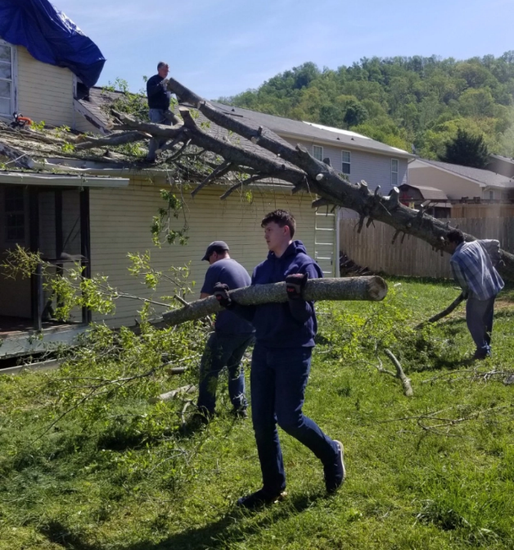
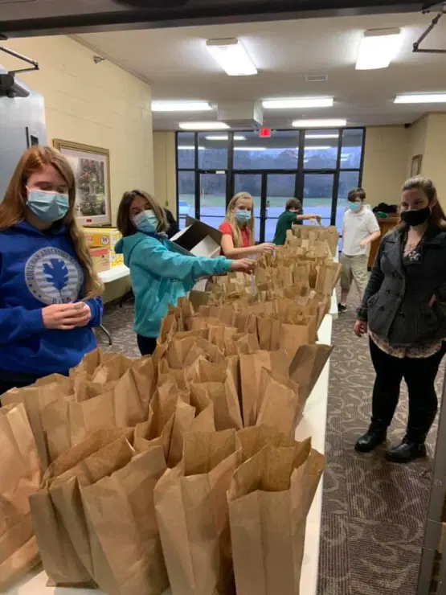
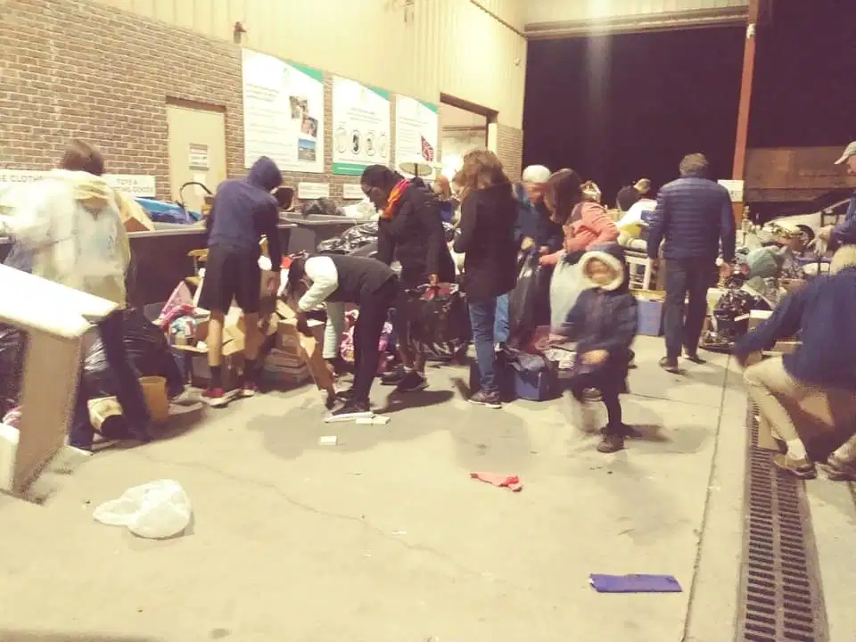
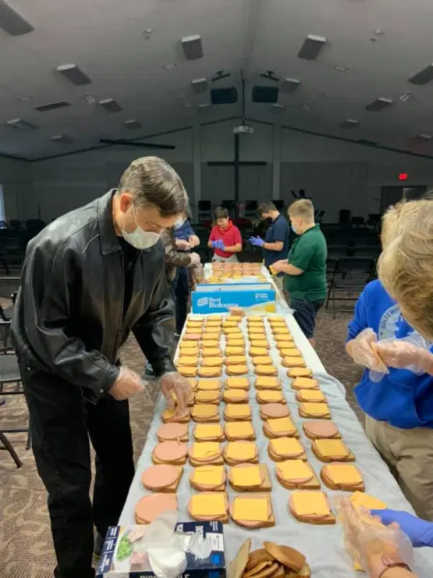
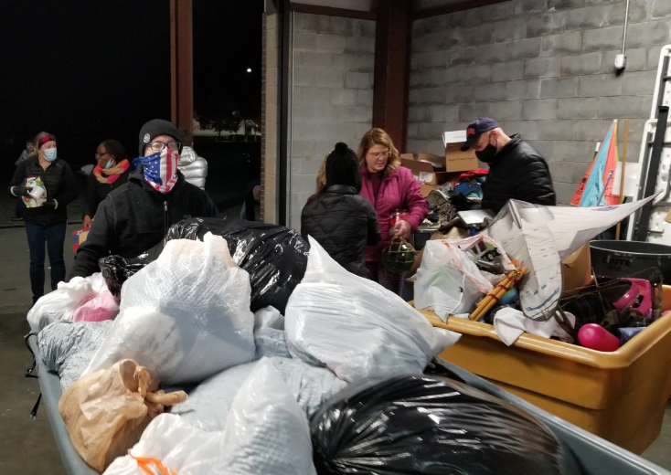
7 Ways to Reach Your Friends for Christ
Community Outreach
David Hartman
www.winningwaystowitness.com
t
Notes:
I’m a member of a very active church - Ooltewah Church. Disaster Response, cleaning debris after a tornado. Making sacklunches for the homeless in Chattanooga. Helping with the Samaritan Center, 1 Saturday night a month, bring in all the donations of clothing/household from the outside.

Slide 26
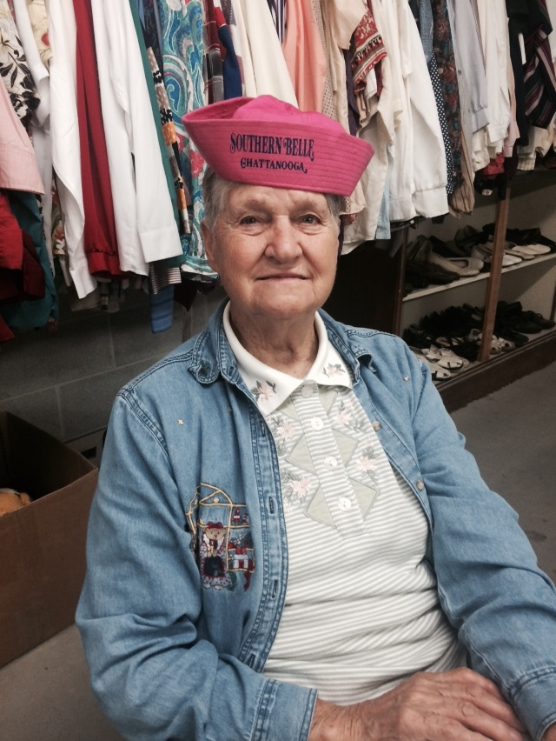
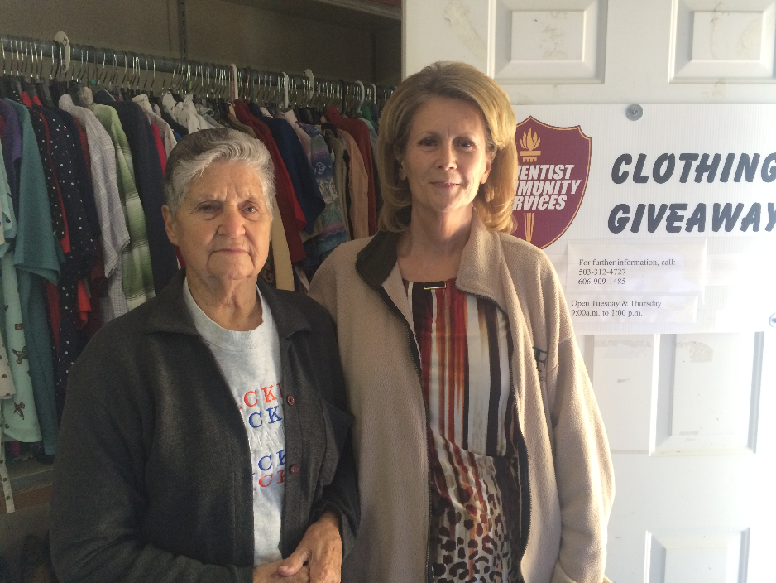
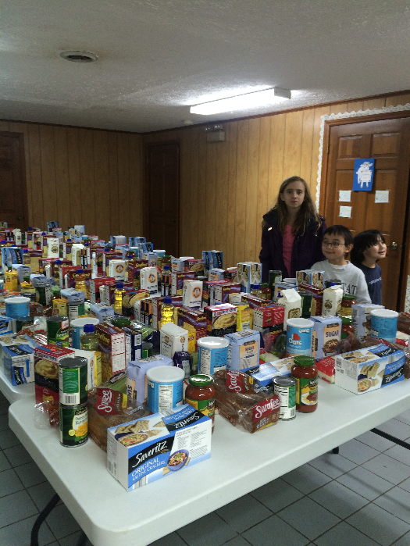
7 Ways to Reach Your Friends for Christ
Harlan Church ACS Center
David Hartman
www.winningwaystowitness.com
t
Notes:
Sadie began coming to the center to receive help, then she began to volunteer at the center herself. Now she regularly attends church.

Slide 27
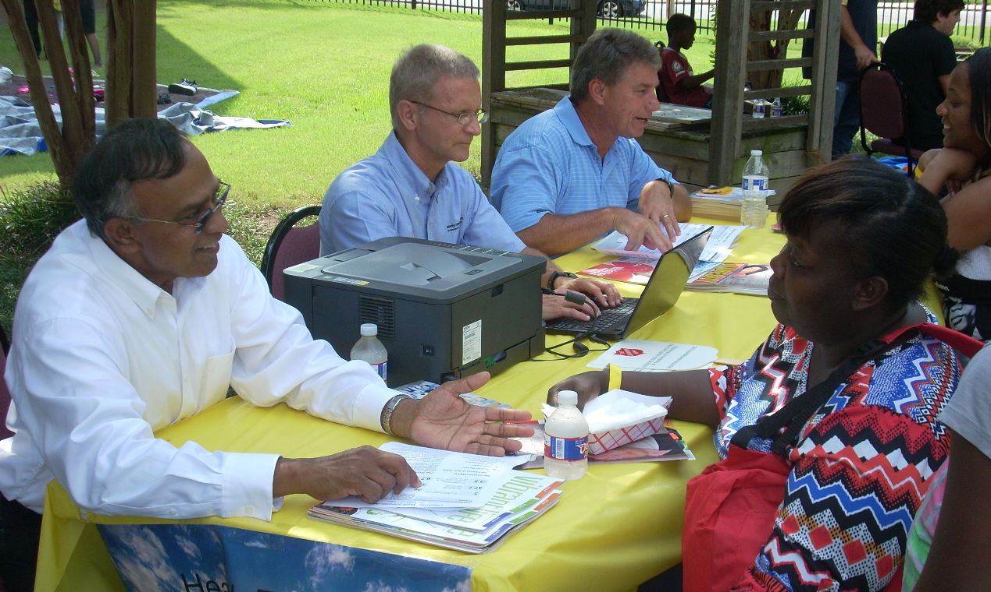
7 Ways to Reach Your Friends for Christ
Raleigh Church Free Health Care at Women’s Shelter
David Hartman
www.winningwaystowitness.com
t
Notes:
MODELO- Monitor 01B

Slide 28
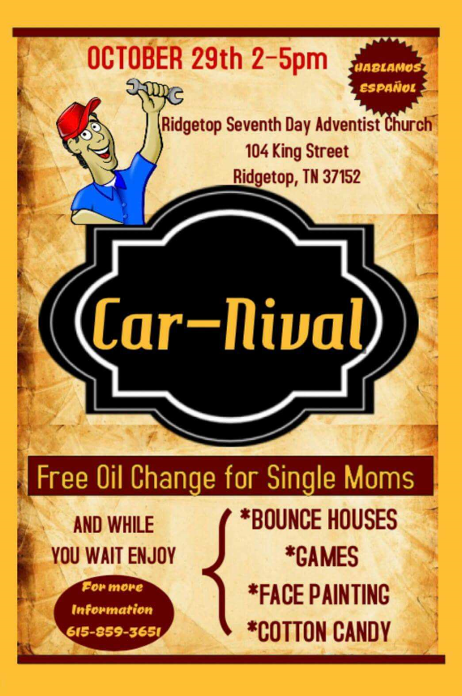
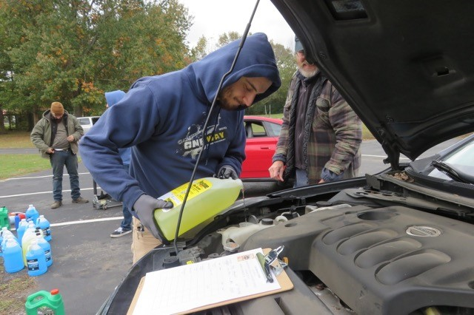
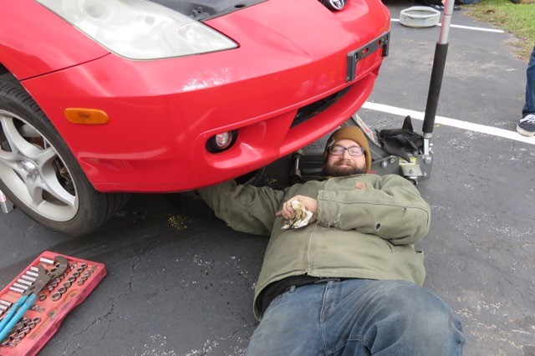
7 Ways to Reach Your Friends for Christ
Ridgetop Oil Change for Single Moms
David Hartman
www.winningwaystowitness.com
t
Notes:
MODELO- Monitor 01B
Here’s some of the practical outreach seminars churches are holding in the community: Ridgetop Church provided a Car-Nival—free oil change and basic car maintenance for single mom’s. While the oil is being changed, there is finger-painting and other activities for the kids.

Slide 29
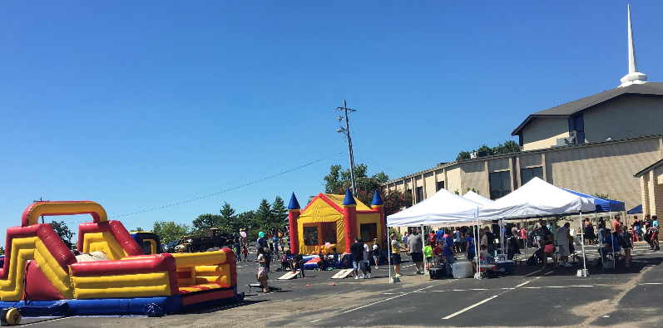
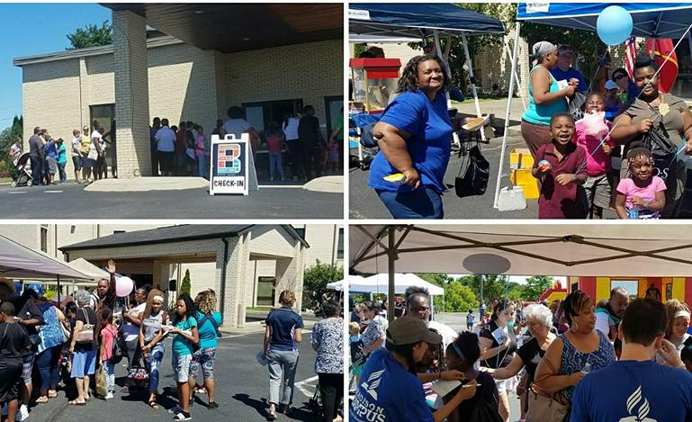
7 Ways to Reach Your Friends for Christ
Madison Church Block Party
David Hartman
www.winningwaystowitness.com
t
Notes:
MODELO- Monitor 01B
Madison Campus Church holds an annual Block Party, where various church ministries and departments give away free food, games, and prizes. A child who visits all the booths and gets their booklet stamped, gets a free backpack filled with school supplies.

Slide 30
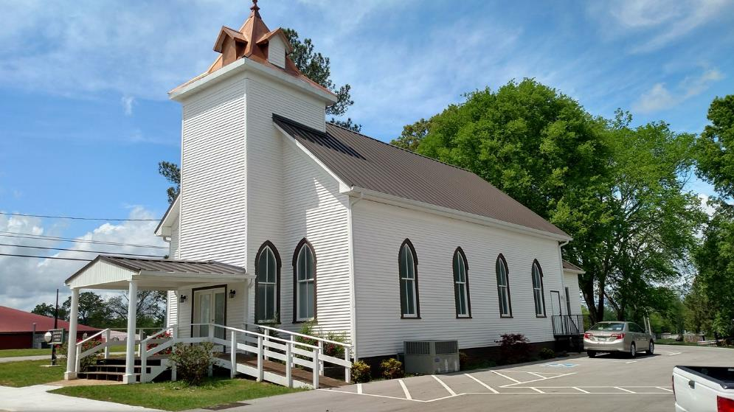
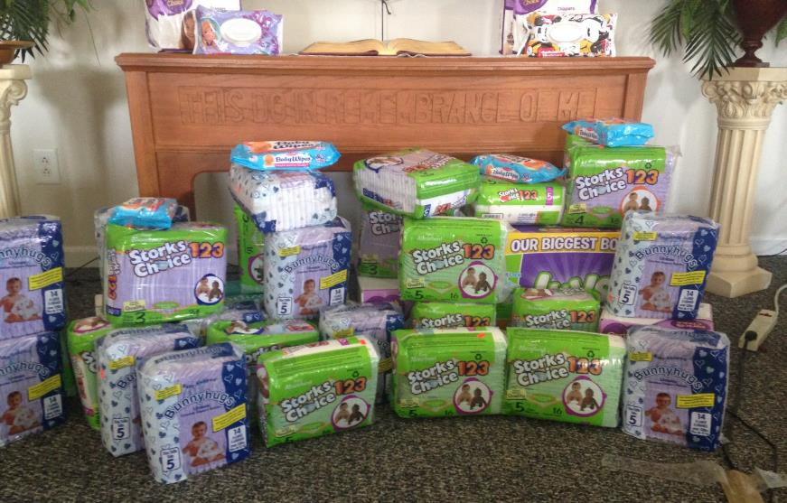
7 Ways to Reach Your Friends for Christ
Decherd Church
Diaper Derby
David Hartman
www.winningwaystowitness.com
t
Notes:
MODELO- Monitor 01B

Slide 31
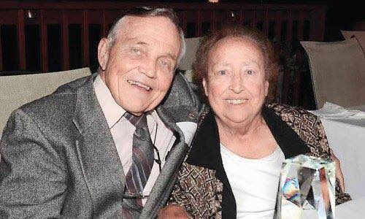
7 Ways to Reach Your Friends for Christ
Tribute:
David Hartman
www.winningwaystowitness.com
t
Notes:
Carl Hartman
I’d like to give tribute to my father, Carl Hartman, and my mother, Betty. Dad served as the pastor of the Andrews and Murphy, North Carolina, Adventist Churches for eight years from 1978 to 1984. Then he and Mom returned to that beloved community upon their retirement for another 20 years from 1996 to 2016. Dad is the epitome of a pastor who loved and served not only his church flock, but also his community.
During his 30 years in Andrews and Murphy, Dad conducted scores of stop-smoking plans, cooking schools, and Eight Weeks to Wellness classes to enhance the health in the community. He also coordinated a walking program simulating the Appalachian Trail, which led residents to trek a total of 18,462 miles. In 2009 Dad served as the grand marshal of the Andrews Christmas parade. Instead of riding in the lead vehicle, he jump-roped the more-than-a-mile route in order to encourage an active lifestyle. For several years, Dad also swam in the local pool about three miles a week and made many wonderful friends there. Dad helped with the citrus fruit program of the Murphy Adventist School and helped to deliver hundreds of boxes of fresh grapefruit and oranges to citizens in Cherokee County. He and Mom also coordinated the monthly MANNA food program in Andrews for ten years, which meant at least 100 distributions of produce to seniors who might not have otherwise gotten fresh food. For Y2K, Dad rang in the historic New Year with a Bible-reading marathon, where participants read aloud from Genesis to Revelation nonstop throughout New Year’s Eve and New Year’s Day.
For Dad’s myriad community contributions, the Chamber of Commerce honored him with the Citizen of the Year award for Cherokee County at an awards ceremony. In a tribute in the Andrews Journal, Stacy Green wrote, “Hartman is known around the county for his large heart and charitable heart. . . . [he] along with his wife, Betty, have been community leaders and set the example for the citizen of the year.”
Unfortunately, Dad fell and broke his hip and suffered a stroke in June of 2015. That put an end to his community service activities, but he was still determined to get out and share Christ’s love with all of his community friends, even though he can only hobble with a walker and is barely able to speak. Three months later, Mom also fell and broke her hip. These health challenges necessitated a move from their beloved home and community to an assisted living center near Nashville in October 2016.
During the week of the move, I perused the businesses on Main Street looking for cardboard boxes to pack up all of Mom and Dad’s belongings. As I explained what the boxes were for, every one of the proprietors remarked, “Oh, we know Carl and Betty Hartman! They have done so much good for our town and county. We will greatly miss them, and you be sure to pass along our love.” What a testimony to a couple who truly loved their community! The examples of John Baker and Carl Hartman cause me to reflect. Have we made inroads into the hearts of the people where we live and work? What are some things we can better do to love and serve our communities? After all, God calls us not only to love our church families, but our communities as well.

Slide 32
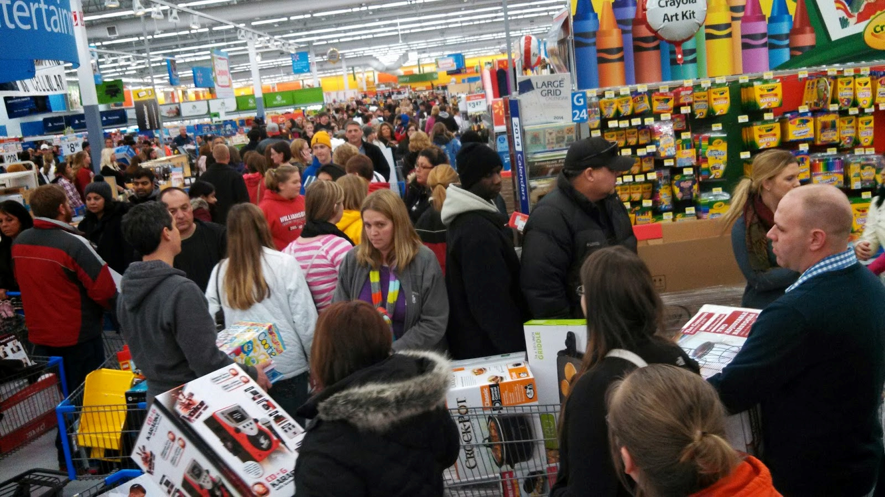
7 Ways to Reach Your Friends for Christ
Open Up More Lanes
David Hartman
www.winningwaystowitness.com
t
Notes:
MODELO- Monitor 01B

Slide 33
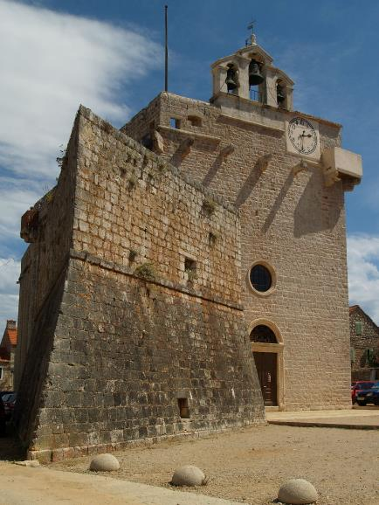
7 Ways to Reach Your Friends for Christ
Expand Walls of Church
Walls too restrictive and confining; need to extend the borders of our church to encompass and embrace the whole community:
“If we would humble ourselves before God, and be kind and courteous and tenderhearted and pitiful, there would be one hundred conversions to the truth where now there is only one.”
EGW, Testimonies, vol. 9, p. 189
David Hartman
www.winningwaystowitness.com
t
Notes:
MODELO- Monitor 01B

Slide 34
7 Ways to Reach Your Friends for Christ
Discussion
What steps can I take to meet the needs of my neighbors next door?
What steps can my church take to meet the needs of our community?
David Hartman
www.winningwaystowitness.com
z
Notes:
MODELO- Monitor 01B

